Slide 1
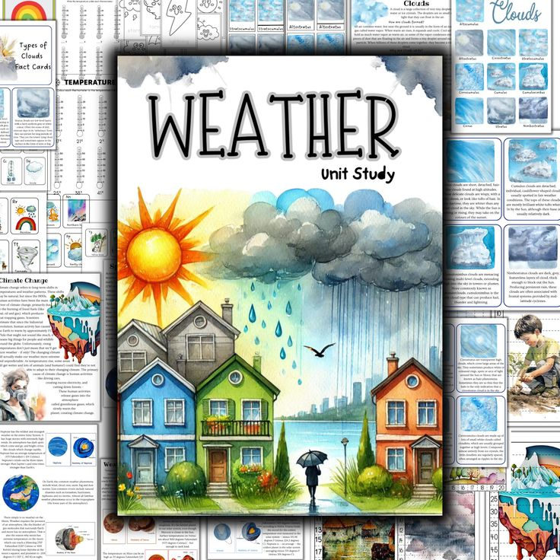
Global Weather Report Analysis.
Presented By:-Ankit Rajak
Project File:-Weather Project Analysis

Slide 2
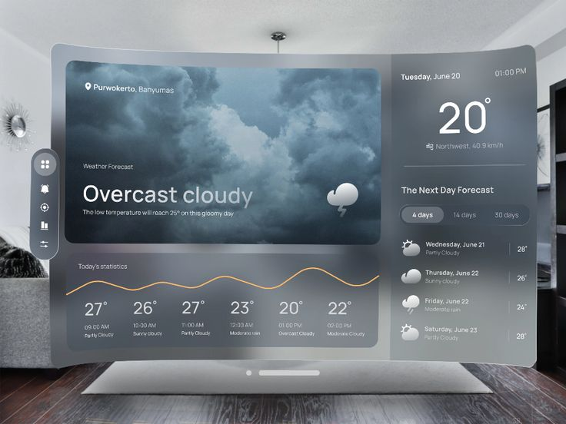
Introduction:-
The global weather project analysis aims to explore and understand weather patterns, trends, and their impact on various regions worldwide. Weather plays a crucial role in multiple sectors such as agriculture, transportation, tourism, and disaster management. This project focuses on analyzing key weather parameters, including temperature, humidity, wind speed, precipitation, and atmospheric pressure, to provide insights into seasonal variations, extreme weather events, and long-term climate trends.
By leveraging global weather data, this analysis seeks to identify patterns that affect everyday life and economic activities. It also highlights regional weather differences and their correlation with environmental and geographic factors. The project will evaluate the effects of global warming, climate change, and shifting weather patterns on different regions.
The ultimate objective of this project is to deliver a comprehensive understanding of global weather dynamics, helping policymakers, industries, and communities make informed decisions related to disaster preparedness, resource management, and adaptation strategies in response to evolving climate conditions.

Slide 3

Objective:-
The objective of a global weather report analysis is to assess and interpret current weather conditions and patterns across the world. This involves tracking temperature trends, precipitation, and severe weather events such as hurricanes and droughts. The goal is to identify significant climate shifts, improve forecasting accuracy, and understand the impact of weather on human activities, including agriculture, transportation, and health. By analyzing data from various regions, meteorologists can better predict weather phenomena and advise on necessary actions to mitigate the effects of extreme weather, helping both policymakers and the public respond effectively to climate challenges.

Slide 4
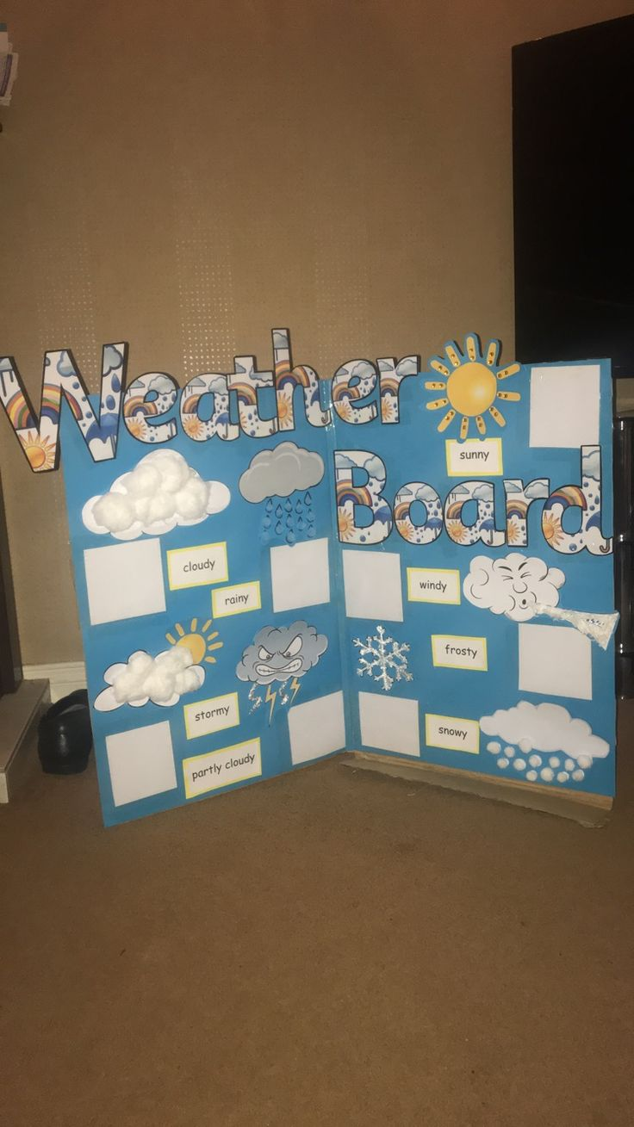
Key Challenges:-
1.What is the average temperature over the entire dataset?
2.What is the highest and lowest temperature recorded?
3.How does the temperature vary over time (e.g., daily)?
4.How does the temperature vary over time (e.g., Monthly)?
5.Is there a correlation between temperature and other weather
parameters like humidity or wind speed?
6.How often does it rain or snow?
7.What is the distribution of wind speed values?

Slide 5
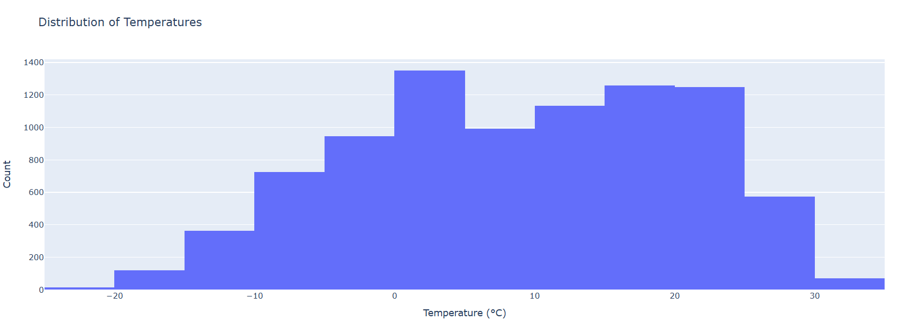
1.What is the average temperature over the entire dataset?
Observation:-The average temperature over an entire dataset is calculated by summing all temperature values and dividing by the total number of data points. This provides a general indication of temperature trends across the dataset, helping to identify regional or global patterns.

Slide 6
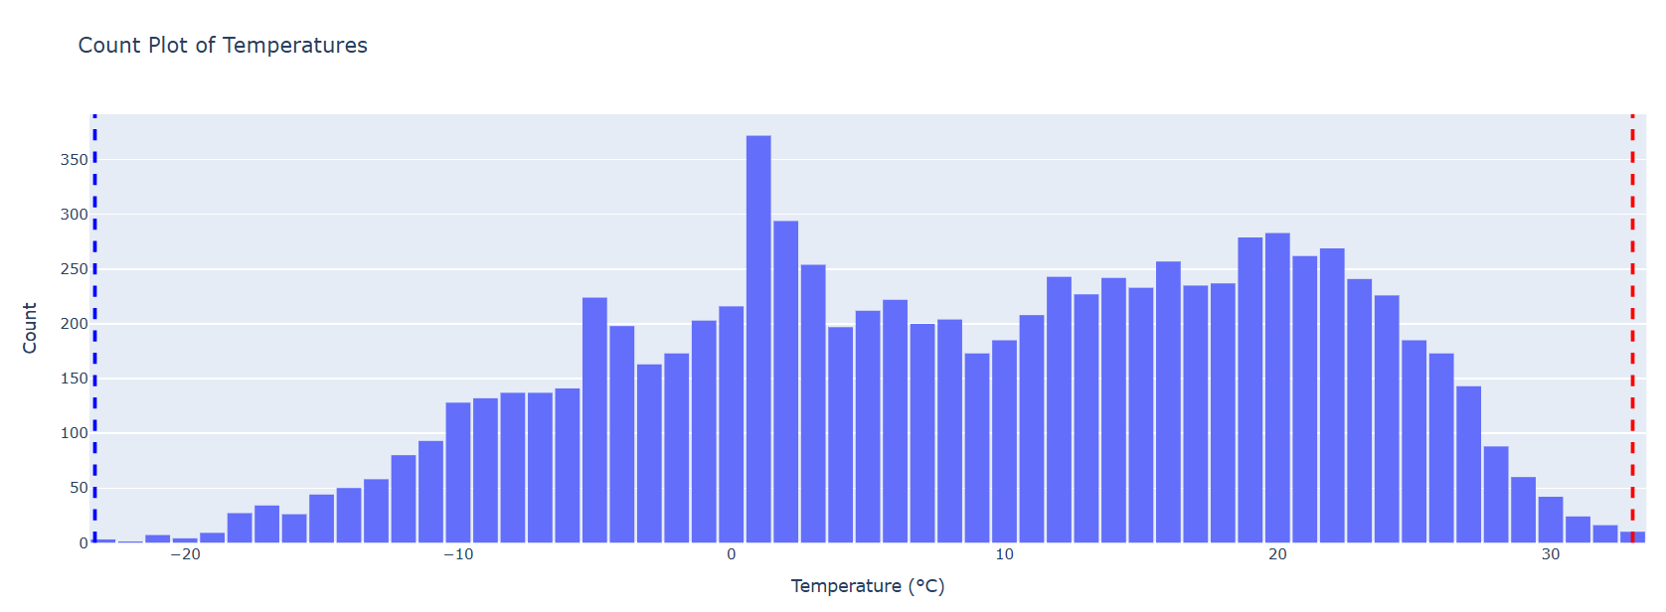
2.What is the highest and lowest temperature recorded?
Observation:-The highest and lowest temperatures recorded in a dataset are determined by identifying the maximum and minimum values. These extremes highlight the range of temperature variations within the dataset, indicating the hottest and coldest conditions observed.

Slide 7
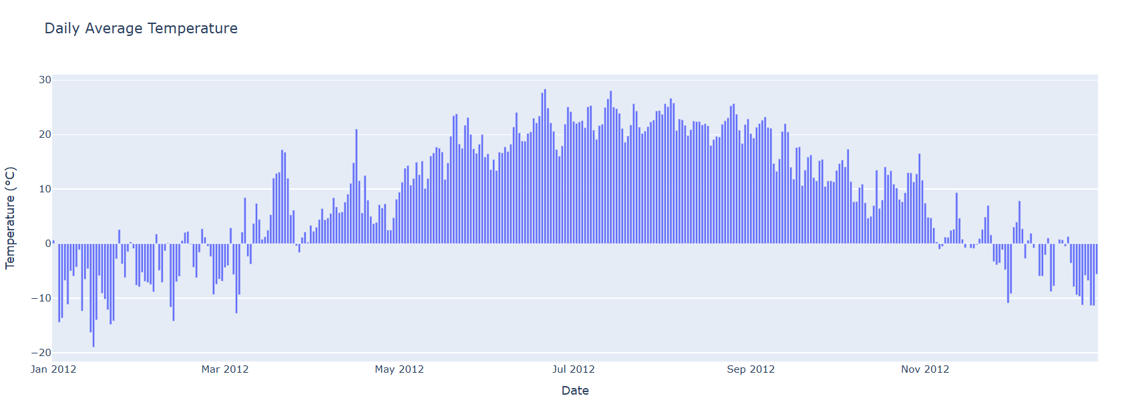
3.How does the temperature vary over time (e.g., daily)?
Observation:-Temperature variation over time, such as daily fluctuations, shows patterns based on factors like time of day, season, and weather systems. Typically, temperatures rise during the day, peaking in the afternoon, and drop at night, influenced by local conditions.

Slide 8
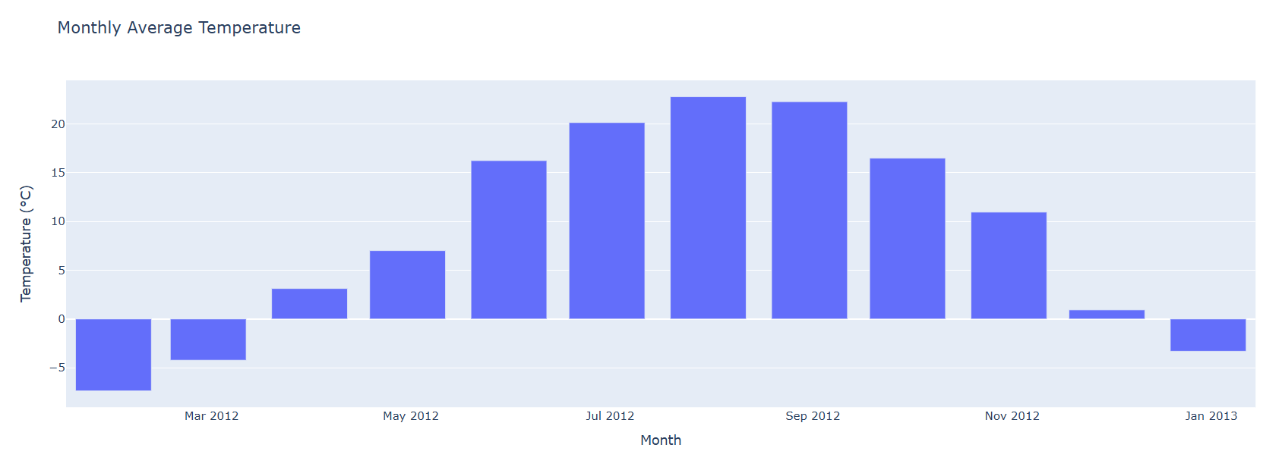
4.How does the temperature vary over time (e.g., Monthly)?
Observation:-Monthly temperature variation typically reflects seasonal changes, with temperatures rising in warmer months and dropping in cooler months. These fluctuations are influenced by Earth's tilt, weather patterns, and geographic location, leading to consistent temperature trends across months.

Slide 9
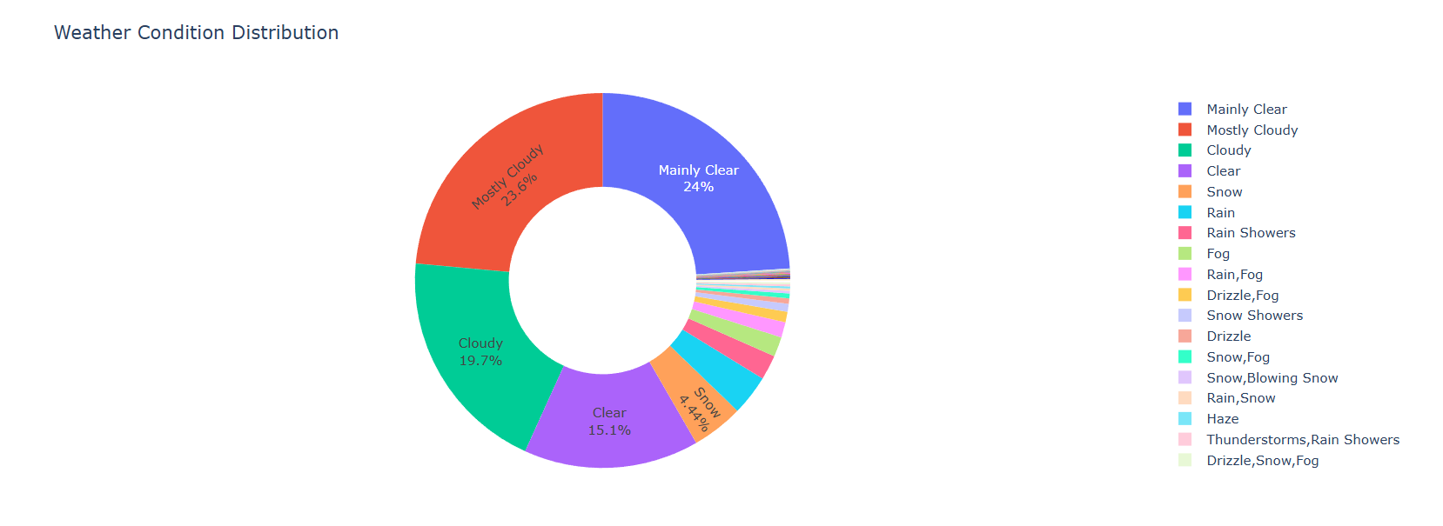
5.Is there a correlation between temperature and other weather parameters like humidity or wind speed?
Observation:-There can be a correlation between temperature and other weather parameters. For instance, higher temperatures often coincide with increased humidity, while wind speed may influence temperature perception. Analyzing these correlations helps understand the broader climate dynamics in a region.

Slide 10
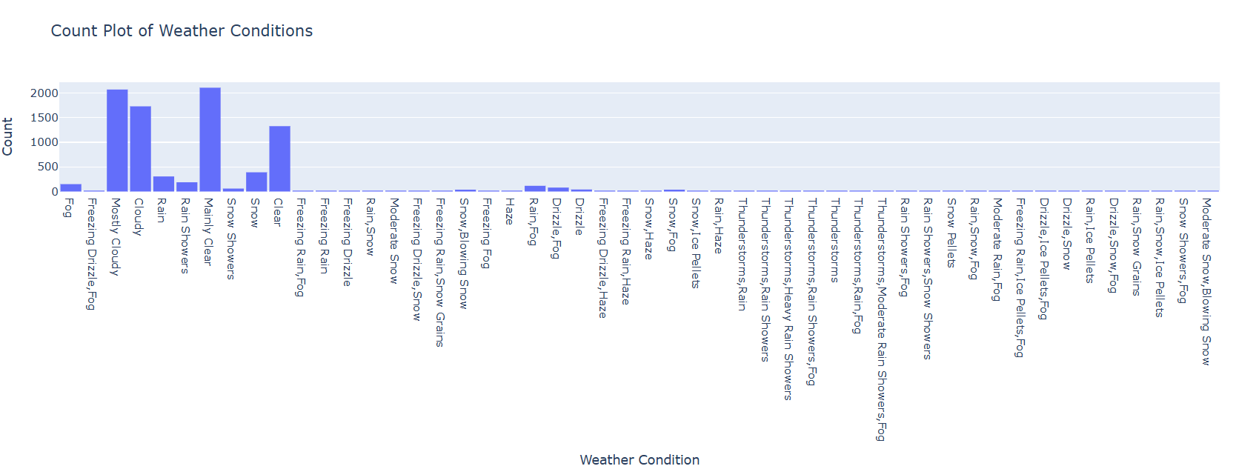
6.How often does it rain or snow?
Observation:-Rain or snow frequency depends on the region's climate and time of year. In temperate zones, rainfall may be frequent during specific seasons, while snow is common in colder months. Data analysis reveals patterns of precipitation occurrence and intensity.

Slide 11
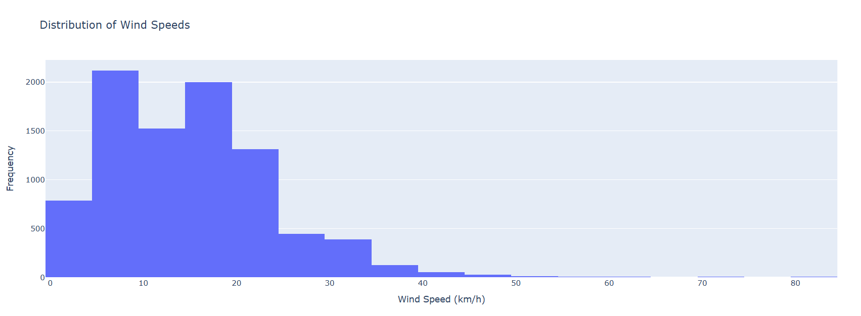
7.What is the distribution of wind speed values?
Observation:-The distribution of wind speed values shows how frequently different wind speeds occur. Typically, most values cluster around moderate speeds, with fewer instances of very high or low wind speeds. Analyzing this helps understand local wind patterns and variations.

Slide 12
Conclusion:-
In conclusion, a global weather analysis provides critical insights into the patterns and trends shaping the Earth's climate. By examining temperature variations, precipitation patterns, wind speeds, and humidity levels, we gain a deeper understanding of the changing climate and its impacts on ecosystems and human activities. The data reveals both regional and global trends, such as the intensification of extreme weather events, shifts in seasonal patterns, and the growing unpredictability of weather systems. Temperature trends, for instance, highlight the rise in global temperatures, which is contributing to phenomena like melting ice caps, more frequent heatwaves, and shifting agricultural zones.
The frequency and intensity of rainfall and snowfall offer clues about changing precipitation patterns, while wind speed distributions help assess the strength of storms and other atmospheric phenomena. Furthermore, correlations between temperature, humidity, and wind speed provide a more comprehensive understanding of how these elements interact in the atmosphere.
Overall, global weather analysis serves as a vital tool for improving weather forecasting, managing climate-related risks, and informing policy decisions that aim to mitigate the impacts of climate change, ultimately guiding efforts to protect both people and the planet.

Slide 13
Thank You So Much

